Slide 5
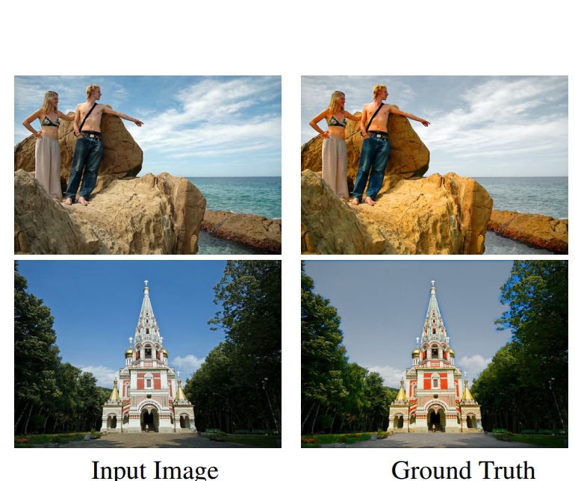
AUTOMATIC IMAGE STYLIZATION USING DEEP FULLY CONVOLUTIONAL NETWORKS : Conventional automatic photo adjustment has difficulty in representing complex color transforms between images before and after adjustment. Most of them merely model global color transforms without considering local semantic contexts. Aim : Given a set of exemplar image pairs, each representing a photo before and after pixel-level color and tone adjustments following a particular style, we wish to learn a computational model that can automatically adjust a novel input photo in the same style.
Abhishek rao

